Slide 1
Sigma Zeta Chapter
Semi-Annual Steering
Summer 2012 Planning Seminar

Slide 2
Overview of Todays Schedule
Itinerary
Chapter Leadership Structure
Officer Goal Setting
Chapter Goal Setting
Fellowship Break (snacks, chatting, networking, etc)
Honors Program Obligations
General Membership Meeting to follow (begins at 6:00PM)

Slide 3
Chapter Leadership Structure
Section 2

Slide 4
Chapter Leadership Structure
Officer Core
President
Vice President
Treasurer
External Communications Officer
Internal Communications Officer
Active Members
Current Active Team Leaders
Service Learning Volunteer
Occasional ‘drive by’ participant
Advisors
Faculty Advisor
Admin. Co-Advisor
Regional Coordinator
Current Membership Rolls
RMCR Regional Presence at Lane
Sigma Zeta Alumni Association
Past Presidents and Officers
Members Transferring to University

Slide 5
All Officers Must:
Before undertaking the responsibility of a core officer position, be sure to realize the time commitment as well as the potential benefits. While you will be asked to serve 5 office hours per week, the time spent in meetings on the chapters’ behalf will count towards that requirement.
Attend chapter meetings and events or notify the secretary with your report
Abide by the Chapter Officer Code of Ethics
Students provide leadership, advisors provide continuity. “These cycles are all about learning leadership, and sometimes advisors need to think ahead to the future harvesting of seeds that may have been sown at the roots of your chapter guidance.” (06-08 ‘Good As Gold’ Chapter Resource Guide).

Slide 6
Chapter President Duties
Preside over all business meetings
Appoint and establish any necessary committees
Vote only in case of a tie
Serve as an ex-officio member on all committees
Present business to the organization
Represent the organization at all times
Appoint a committee to review and/or revise the chapter bylaws annually
Appoint a committee to prepare the Annual Report to be sent to headquarters in spring

Slide 7
Chapter Vice President Duties
Perform all duties of the president in the event of his or her absence
Take roll at the meetings if the Internal Communications Officer is absent
Head the committee reviewing the chapter bylaws and the annual report
Become president in the event the president cannot complete his or her term
Coordinate activities related to the Honors Study Topic
Provide documentation and other records of Hallmark activities
Coordinate all committees and head the event planning of the chapter
Act as liaison to the Regional Officers

Slide 8
Chapter Treasurer Duties
Conduct regular Bookkeeping for all Chapter accounts + Control and Account for the chapter petty cash fund (if it gets approved)
Be present at all fundraisers and follow ethical money handling procedures
Provide a verbal 'club account' and 'cash' balance at every meeting + distribute a monthly hardcopy financial/inventory report
Take great care to adhere to Lane COPPS policies and report any issues to both the president and the advisor
Resource Management - Keep Inventory, and coordinate with Chapter President for sponsor 'ask' when necessary

Slide 9
External Communications Officer Duties
Take a primary role in public or published chapter documents: responsible for producing professional event reports, research conclusion papers, forms, and Hallmark recognitions submissions
Coordinate Regular Chapter Communications (phone messages, memos, and email as directed by president)
Produce a Chapter Newsletter (monthly membership circular that showcases current events, upcoming and recent projects, and chapter contact information)
Be responsible for all external Communications: Webpage, Social Netorking, Torch Articles, News Releases, Media Advisory, etc.
Coordinate with the Internal Communications Officer for the annual Yearbook

Slide 10
Internal Communications Officer Duties
Take roll and record minutes at all general and executive meetings
Compile an ongoing binder of agendas, sign-in sheets, and meeting minutes for institutional knowledge (flyers and copies of published articles should be placed into record as well)
Record data numbers for the chapter at each and every event (count people, take pictures, gather surveys)
Coordinate with the (External) Communications Officer for the annual Yearbook
Assist the officer core to write the essays for Hallmark and Regional recognitions

Slide 11
Member Roles – Current Active Team Leaders
Honors Research Project Manager
Membership: Recruitment & Retention Coordinator
Visibility/Marketing/Poster Campaign Manager
Photographer/Videographer/”Yearbook” Editor
(Alumni) Transfer Support Coordinator
Service Learning Volunteer Program Coordinator

Slide 12
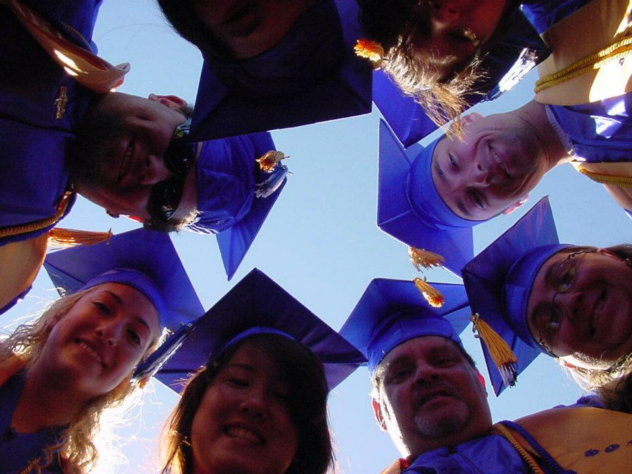
Chapter Officer Goals
Section 3

Slide 13
Skill Development
Computer Skills
Communication Skills
Keyboarding and Data Entry
Formatting a professional document
Word Program experience
Excel Program experience
Power Point experience
Publisher experience
Access… introduction
Drafting Professional Chapter Correspondence and Officer Reports
Developing and delivering formal presentations on research, event recruitment, membership drives, outreach, and community service
Representing Sigma Zeta chapter at campus events

Slide 14
Leadership Development
Planning & Management Tools
Troubleshooting and Challenges
Clear Definition of Roles, Expectations, and Support Structure
Effective SMARTER Goal Setting
SWOT Analysis and Solution Set
Simultaneous attention to the needs of the team, the goals of the group, and the mission of the Sigma Zeta Chapter of ΦΘΚ.
Conflict Resolution and Diffusing problems before they arise
Dealing with difficult people, and realizing that sometimes WE are the difficult person
Seeking solutions to challenges and taking the time to reflect on all aspects of a project – to find ways to improve future outcomes

Slide 15
Exercising Leadership
Leading Meetings, Delivering Workshops & ‘Class Raps’, or representing the Chapter in any capacity
Coordinating Events, Logistics, Campaigns, and Projects
Organizing Committees and Delegating Tasks
Strategically Planning and Follow-through with structured development of student leaders. Compassion and Empathy to understand the struggles and strife of students who may or may not meet expectations.
Exercise effective time management and recognize the warning signs of trouble; reach out to your team if you need help meeting a deadline.

Slide 16
5-Star Chapter Goals
Section 4

Slide 17
Chapter Goal Setting
Committee List
Fall Chapter Calendar
SOLVe Semi-Annual Service
Welcome Freshmen (Recruiting)
Campus Beautification and Adopt-A-Road 30th Avenue Clean-up
Founders Day Celebration
Car Smash (Fundraiser)
Fish Pond (Fundraiser)
Lane Preview Night (Outreach)
Graduation (Ushers) Committee
September 4 & 5 SOAR
College Project Meeting Sept 17th
September 20 Fall In-service LCC
September 22 SOLVe Fall Creek Pk.
October 12 Regional HIA Conf.
November 1 & 2 Achieving the Dream Conference at LCC
Civil War Ducks vs. Beavers 11/24
HIA Deadline December 31, 2012

Slide 18
Chapter Goal Setting Continued
5-Star Chapter Requirements
Pinnacle Recruiting
See Handout for details
Refer to the Poster for our progress, update at each meeting from now until we reach our goal of 5-Star Chapter!!
Chapters will earn up to five scholarships of $45 each (covering International fees), based on increasing membership over the previous year in 5 percent increments.

Slide 19
Break
Section 5

Slide 20
Honors Program Obligations
Section 6

Slide 21
Honors In Action Planning Model
Review the Honors Planning Model
Plan and schedule a research report debriefing for the 3rd week in September. Each officer and the CATL will present their findings. Expect to make this a half-day workshop with a potluck lunch and maybe a speaker.
Officers will be assigned a sequences of sources to research in the next month (add a few more too; if your reading and research takes you in a new interesting direction, go – provided that you make sure to take down the source info)
Research FIRST!!! We need to do the legwork now instead of later!
Honors in Action project selection comes afterward. A date can be set for our project event, however. Either early October or Early November.

Slide 22
Research Sources
Scholarly articles, trade journals, expert Blogs…
Personal Interviews
Athletes
Programmers/geeks
Educators
Historical References, Encyclopedias, Dictionaries, Wikis
And?...

Slide 23
Leadership Roles in the Research Team
Who’s on First? (pardon the Laurel and Hardy pun)
The Vice President is in charge of the chapters Honors activities
Who’s on Second?
CATL titled “Honors Research Project Manager”
What about Shortstop?
External Communications Officer
Who’s on Third?
Internal Communications Officer
Who’s at Home? – the President, because ultimately they are the face of ΣΖ

Slide 24
Timeline
Research Phase
Honors In Action Project Phase
Each officer takes responsibility for a significant number of pages/articles to read and report back to the team any pertinent details.
This body will reconvene in the middle of September to present their research results. Consider and discuss the outcome of not completing your portion of the necessary research
At the beginning of Fall term, we will hopefully be two or three weeks into planning the HIA project. If that is not the case, strategically plan for the contingency by blocking out the date to implement the project plan - before we actually know the nature of the project. Week 2 or the end of week 6, with the Achieve the Dream Conference

Slide 25
General Membership Meeting 6:00 PM
Section 7

Slide 26
August 13, 2012 General Meeting Agenda
Call to Order
Question of the Day “name a/what is your 5-Year Goal” and Roll Call (sign in sheet)
Consent Agenda (see handout for more detailed agenda)
Approve or “Table Definitely” the Minutes from last meeting
Reports
Old Business
New Business
Upcoming Events
Items or Requests for next Meeting August 20, 2012 at the Chapter Office 17/312
Adjournment

