Slide 1
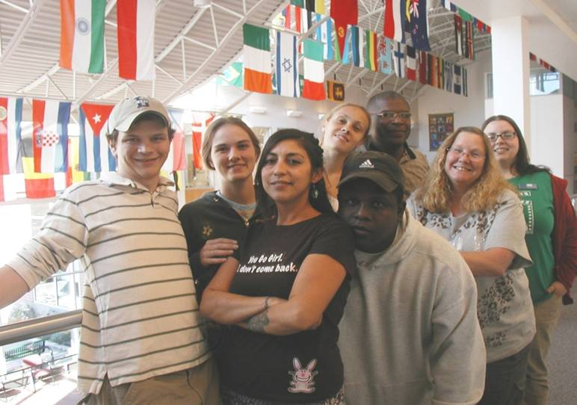
Student Success is Everyone’s Responsibility: Integrative Faculty Development at Lane
Anne McGrail, PhD
Mary Parthemer, MSW, LCSW
Lane Community College
Eugene, Oregon
mcgraila@lanecc.edu
parthemerm@lanecc.edu
https://www.lanecc.edu/lc/fresources/faculty-resources
Notes:
Title III Strengthening Institutions Program Grant, 2008
Fifth and final year
“Engaging Students” – Goal to develop a comprehensive, integrated (Academic and Student Affairs) First Year Experience

Slide 2
Our Work Today
Talk about the development of a student success culture at Lane
Overview of our institutional strategies
Focus on our Faculty Development
How Faculty Development fits into a shift from a “Freedom to Fail” culture to a “Right to Succeed Culture
Invite you to consider your own student success culture

Slide 3
Systemic Change
A comprehensive, integrated FYE
Takes developing a common language – Success Principles, College Knowledge, Right to Succeed, Everyone’s Responsible
Intentional
Collaborative
Integrated
Comprehensive
Notes:
Eliminate? Is this slide needed?

Slide 4
Noel Levitz Student Success Formula: Touchstone of Our Student Success Design
Engagement + Learning + Satisfaction = Student Success
(2003)
All changes and improvements have been mapped onto improving of one of these elements.
Provided clarity and direction throughout.
Evaluation based on these elements.
Notes:
Started focusing on student success in 2003.
Institutional Team to seminar on improving success for TRiO students led by Vincent Tinto
Noel-Levitz Conference on improving retention and success…found and adopted this formula for student success.
This formula was the foundation for our Title III Strengthening Institutions grant program.
Deep learning does not occur without student engagement. Student engagement does not occur without faculty development.
Engagement, Learning and Satisfaction were the factors that we built our evaluation plan on.
YEAR? Optimal Preparation, Progression and Completion

Slide 5
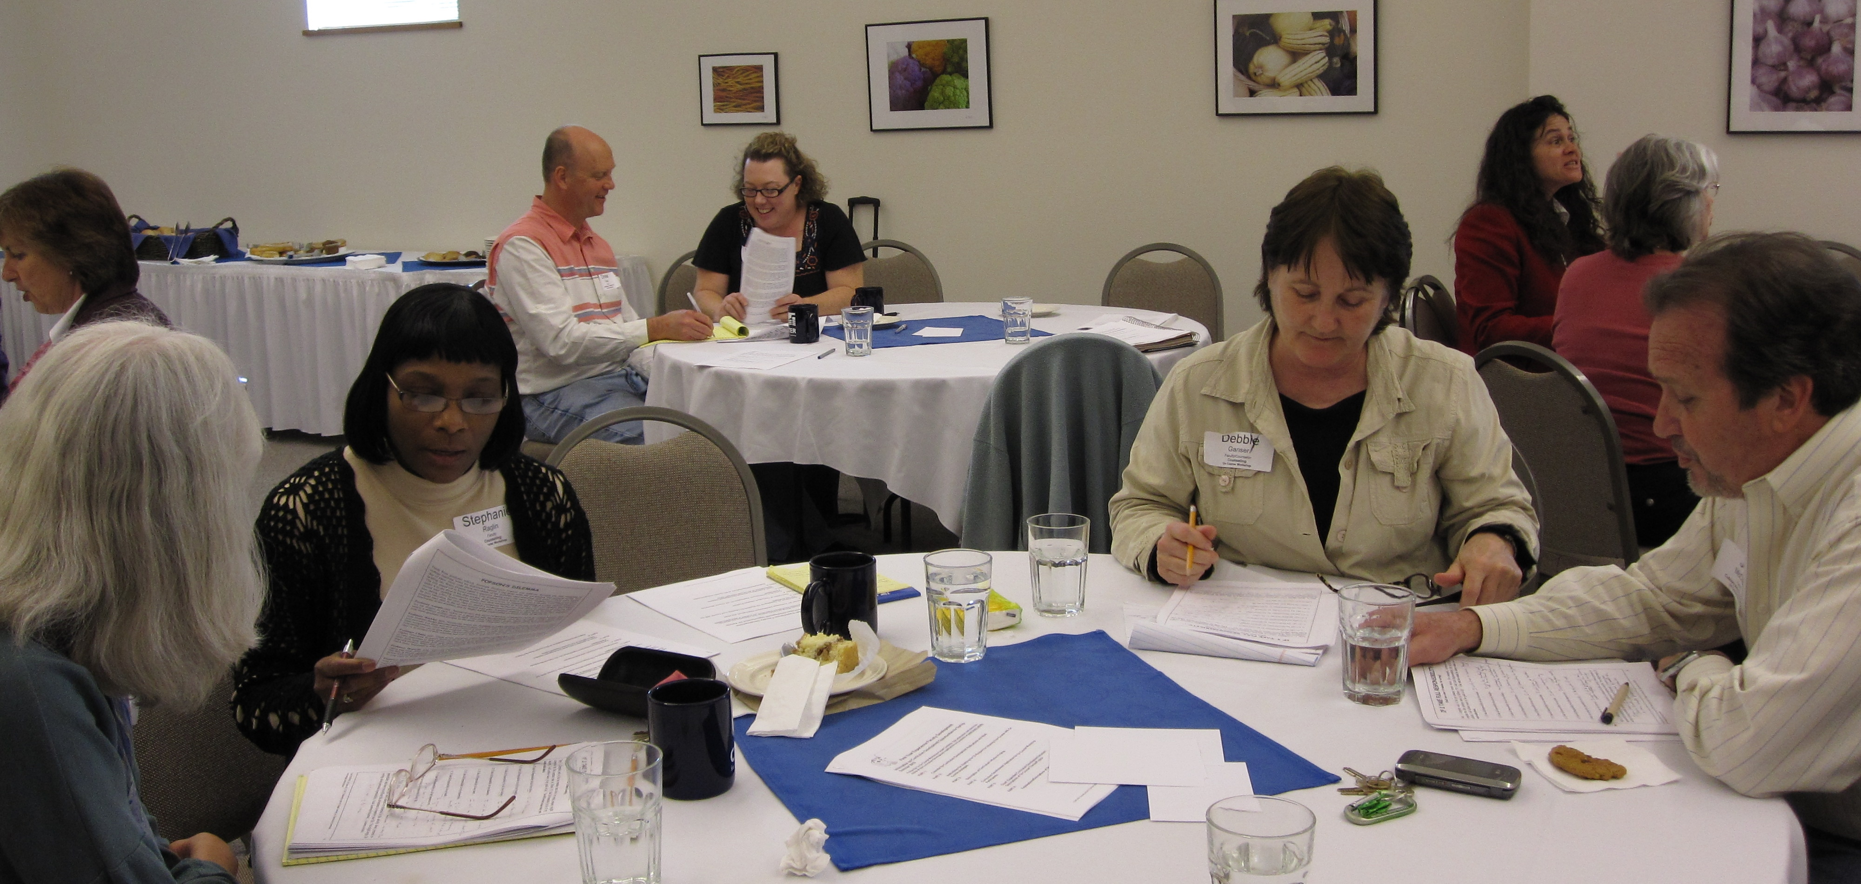
Changing Lane’s Culture for Student Success
Numerous FYE strategies to improve success
Faculty Development was one strategy
Discovered that intentional faculty development strategy is absolutely critical to improving engagement, learning, and satisfaction
Not an add-on
Dynamic and responsive
Developmental-room to grow
Requires skilled, committed
leadership
Committed resources
Multiple opportunities over extended period
Notes:
Strategies include:
Enhance the First Year Experience (FYE)
More first-year Learning Communities
Faculty and Staff development focused on engagement and success
Front-loaded services/early intervention
Required new student orientation
Mandatory advising and academic planning
Success-oriented academic pathways
Enhanced communication through student portal
Assess progress and continually improve
Committed resources to develop knowledge and abilities to integrate success principles, expand learning strategies and collaboratively develop engagement model

Slide 6
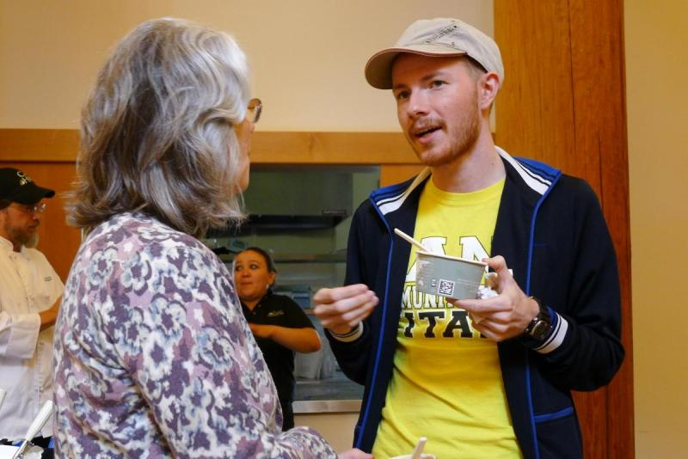
Our Working Assumption: Engaging faculty would lead to increased student success
We knew that student engagement leads to increased learning,
persistence and success.
Faculty engagement
with students,
with each other,
with engaged pedagogy
with a culture of student success
would lead to improved learning environments for engagement and student satisfaction

Slide 7
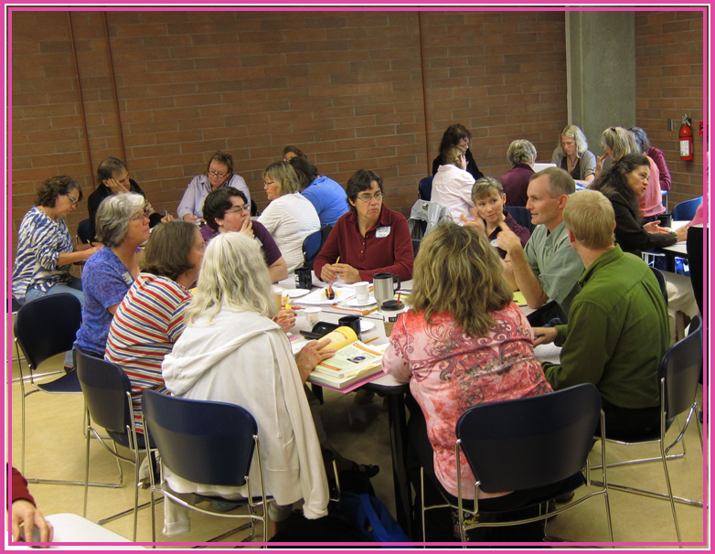
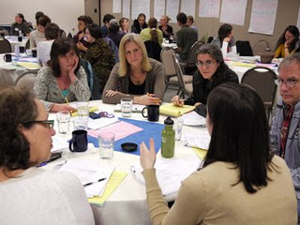
Making Faculty Engagement Happen
“Students don’t do optional.”
Engaging students must be integrated and intentional.
Likewise with engaging faculty: engaging busy community college faculty (many of whom are part-time and work at more than one job) in the work of improving learning and satisfaction must be intentional and integrated.
It has to happen by design.

Slide 8
An Intentional Shift from a Freedom to Fail Culture
Identifying Features at Lane
“Silo effect”: weak coordination between Academic & Student Affairs
“Students’ free choice" of course selection regardless of preparation
“Revolving door”: students fail--and re-take--classes for which they’re underprepared
“Anyone can take my class.” Inadequate structure for and application of placement tests and prerequisites
“Why Don’t They Already Know…..?” Students expected to know college customs and how to succeed in college
“Tutoring is for underachievers” Tutoring services stumbled upon or avoided.
Notes:
Include the link to Anne’s article on Moving from a Freedom to Fail to a Right to Succeed culture…

Slide 9
Freedom to Fail Features on Your Campus: What Are They? How Might You Change Them?
Activity:
Create quick list of “freedom to fail” policies/practices at your institution (SOLO 1 min)
In groups of 3: briefly share one “freedom to fail” practice and its impacts (SHARE 5 min)
As a group, choose a common “freedom to fail” practice and brainstorm what you think a “right to succeed” solution might look like (5 min)
Discuss with the room

Slide 10
Creating a Right to Succeed Culture Faculty Development at Lane
Right to Succeed Assumption | Engaging Faculty
Students deserve to start where they are and incrementally build on their learning | Skills inventory to increase faculty understanding of what’s needed in their classes (Placement, prerequisites, preparation “P-3” Committee)
Recognize and emphasize the critical nature of both curricular and co-curricular learning to students’ success | Workshops that help faculty to embed college success principles and co-curricular features as well as engaging pedagogies
Must teach the college systems, policies practices, and how to navigate them prior to students getting tangled in red tape. Timely, repeated in multiple ways, multiple times, by multiple people. | Developing faculty expertise in college systems beyond their department and discipline. “Mid-term student self-assessments” distributed in Week 5 to remind faculty of an appropriate advising role they are best at playing.
It takes time and context to learn a new culture | Starting with incremental changes, adjusting along the way, adding new programs and opportunities, workshops. Expanding what works…
We are all responsible for student success | Creating a language for all to talk about student success—now in the mission of the college, in the accreditation documents as indicators of achievement
,

Slide 11
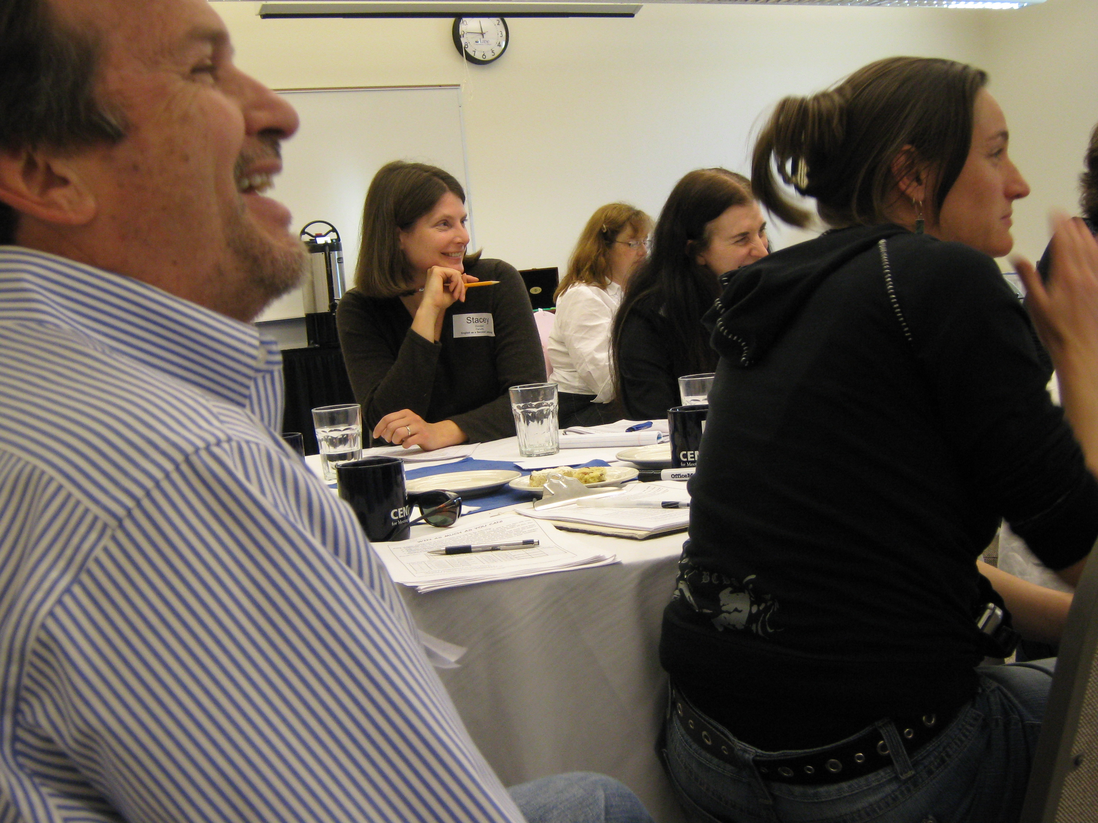
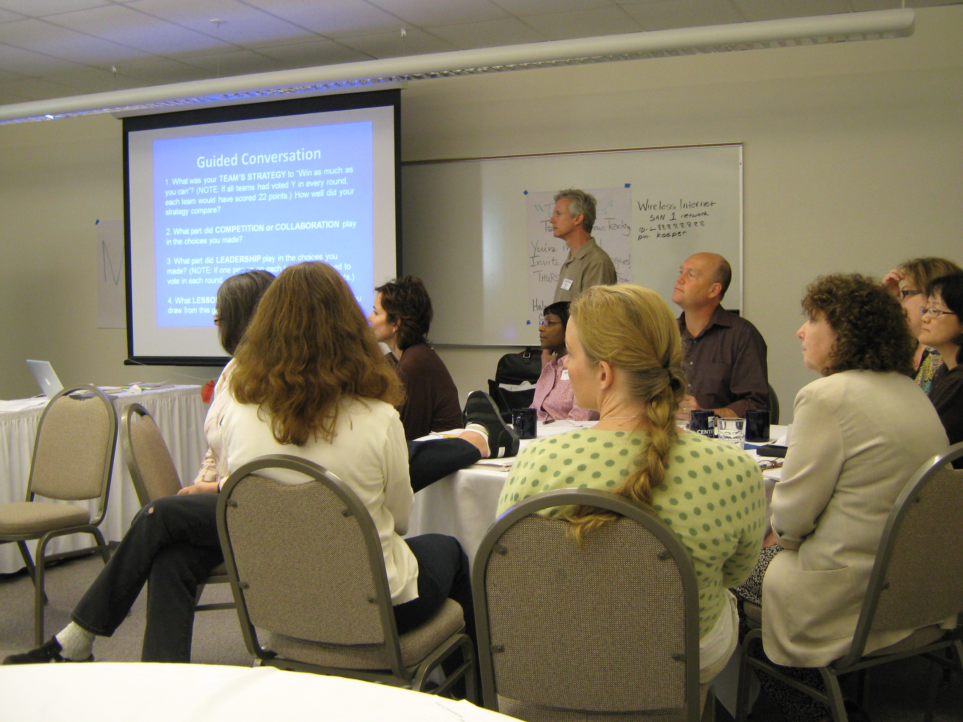
Engaging Faculty in a Right to Succeed Culture
First effort:
On Course Workshop
A focus on pedagogical strategies.
learner-centered structures and strategies across curriculum
empowerment strategies for developing active, responsible and successful learners
Notes:
We embarked on various related faculty development activities that purposefully focus on pedagogical strategies and high impact practices. Each year we have conducted fall and spring workshops, as well as monthly teaching conversations inspired by the desire for faculty who are working with the On Course curriculum in their discipline courses to discuss what they’re learning, talk about challenges and share successes. Connected to these learning activities is a curricular infusion program for faculty teaching in or out of our On Course learning communities. Faculty members were given mini-grants to embed On Course strategies and principles into their discipline-area courses. Twenty such mini-grants have been offered each year, which has resulted in a much broader understanding of the On Course principles college-wide and reinforces student learning.

Slide 12
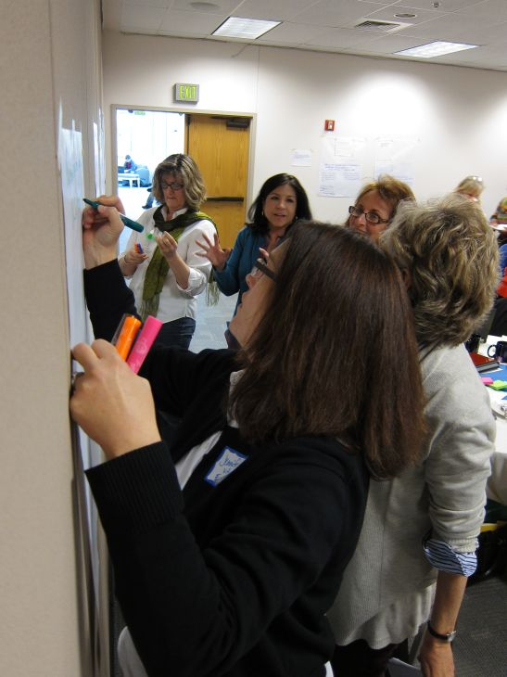
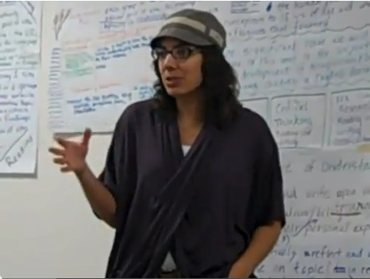
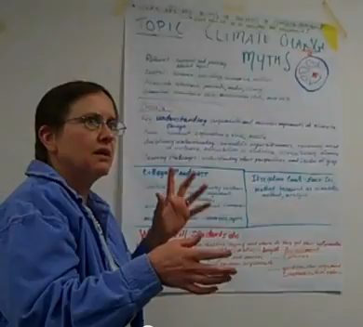
Integrative Learning Workshop for a Right to Succeed Culture
Developing purposeful integrative learning experiences that improve “college knowledge” and enhance disciplinary understanding.
Videos of assignment designs here: https://www.lanecc.edu/lc/fresources/faculty-presentations

Slide 13
High Impact Practices for a Right to Succeed Culture
Notes:
What is the message here?

Slide 14
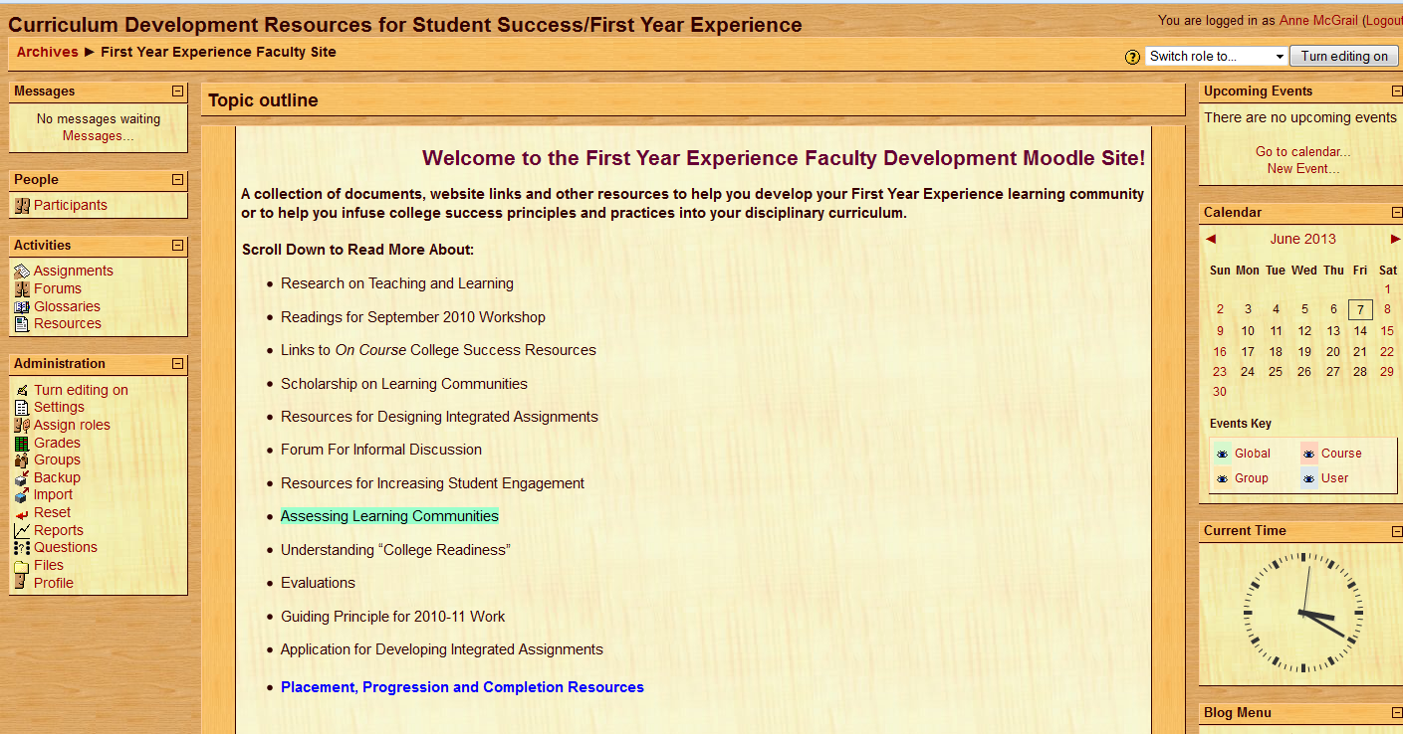
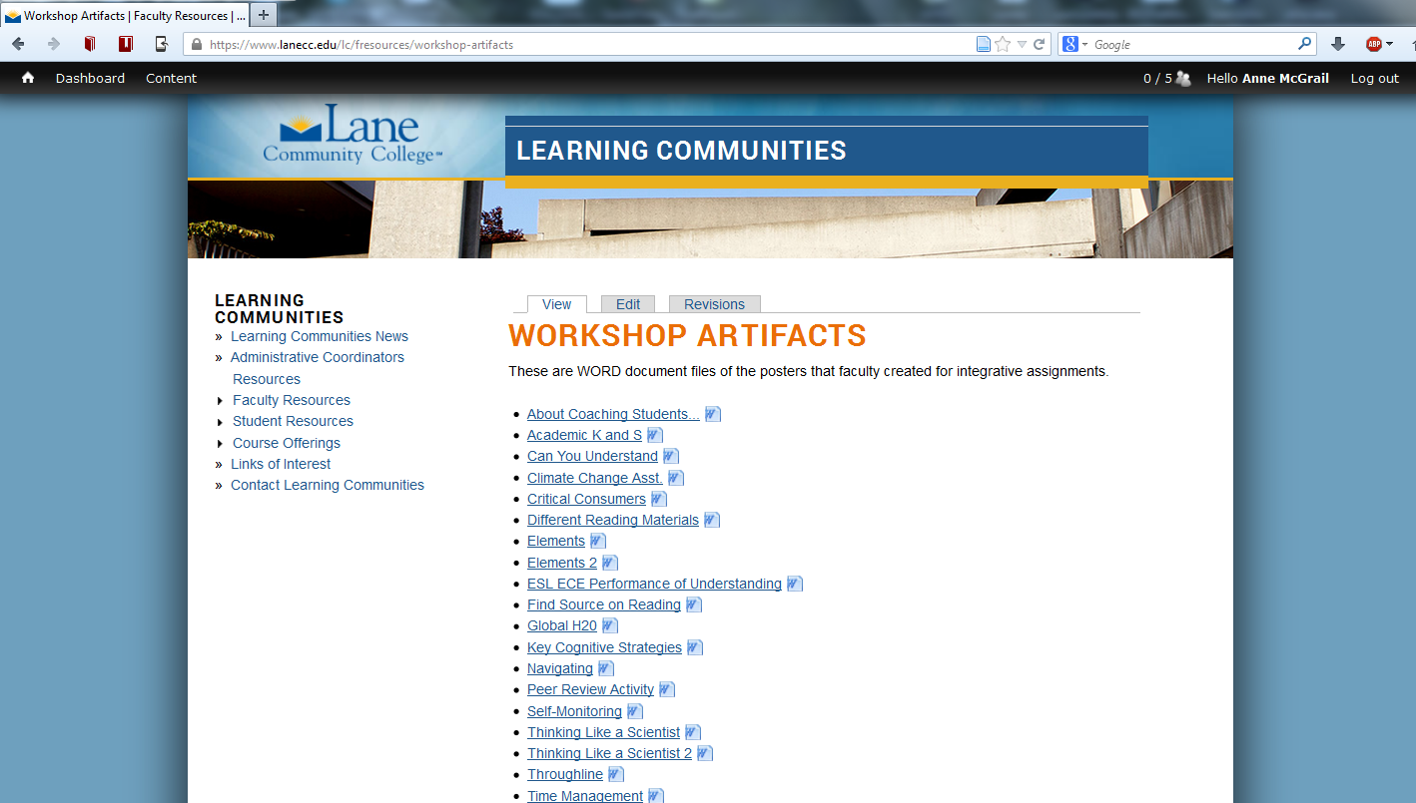
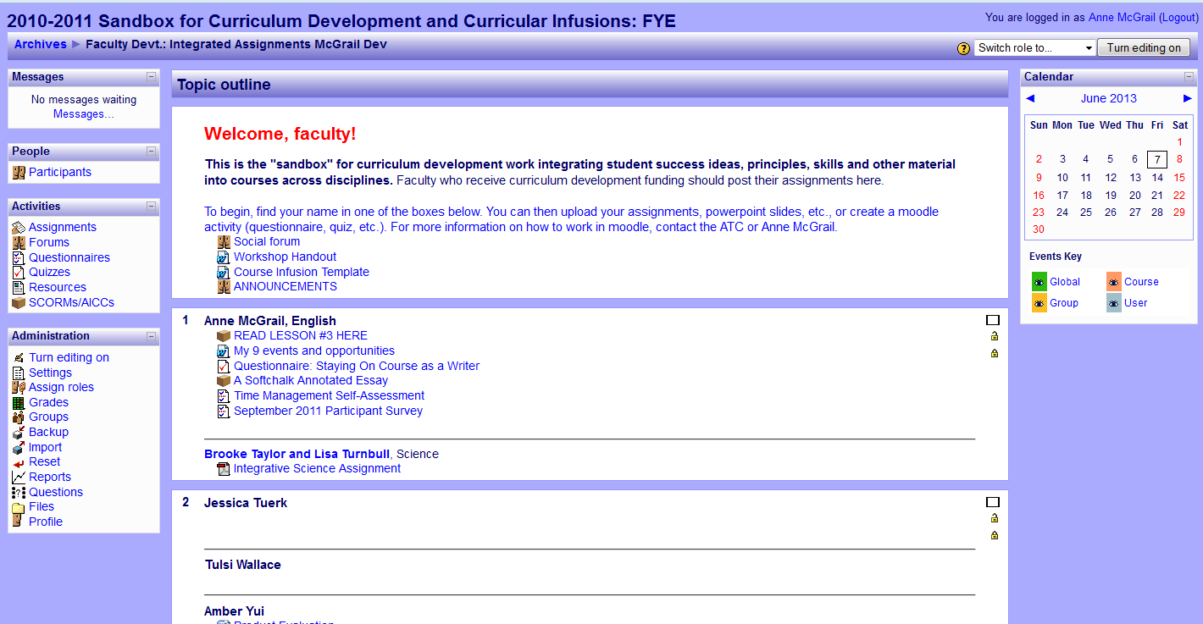
Workshops and Curriculum Development and Infusion for a Right to Succeed Culture https://www.lanecc.edu/es/lc/fresources/curricular-infusion-project

Slide 15
Tea and Topics for a Right to Succeed Culture https://www.lanecc.edu/es/lc/fresources/tea-and-topics

Slide 16
College-Wide Conversation for a Right to Succeed Culture
Inservice presentations for broad dissemination of “Right to Succeed” language about:
Integrative Learning (“Titan Ed Talk”)
First Year Matters (Spring Conference)
Placement, Preparation and Prerequisite (“P-3”) Inventory
First Year Philosophy
https://www.lanecc.edu/asa/titan-ed-talks
Notes:
Can we put in the link?

Slide 17
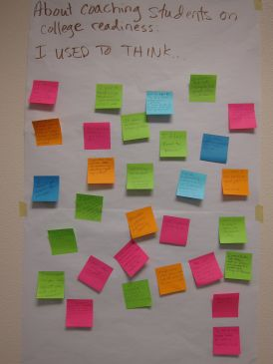
Emerging Right to Succeed Culture
Shared value “right to succeed”
Common language to talk about it
Strategies to implement it across disciplines
Breaking down silos—”everyone’s responsible”
We now have an environment for the next level of Right to Succeed culture
Notes:
A Lane culture has emerged in which the importance of opportunities to talk across disciplines, and across both Student and Academic Affairs about curricular trouble spots, student success strategies, and embedding college knowledge is acknowledged and highly valued. Students are surveyed every term and the On Course curriculum regularly figures prominently and positively in students’ comments. These students are more engaged and achieve better outcomes than other FY students. The culture of student success that has grown around the adoption of On Course and related activities has helped Lane faculty, instructional support, and student affairs staff commit to explicit instruction and reinforcement for student development and success.

Slide 18
Cultural Shifts at Your College
Activity:
Individually create quick list of cultural shifts required to implement right to succeed solutions at your institution? (SOLO 1 min)
In groups of 3, each person briefly share one cultural shift needed (SHARE 5 min)
In groups of 3, select one cultural shift and brainstorm faculty/staff development strategies that will contribute to the needed cultural shift (5 min)
Discuss with the room (3 min)

Slide 19
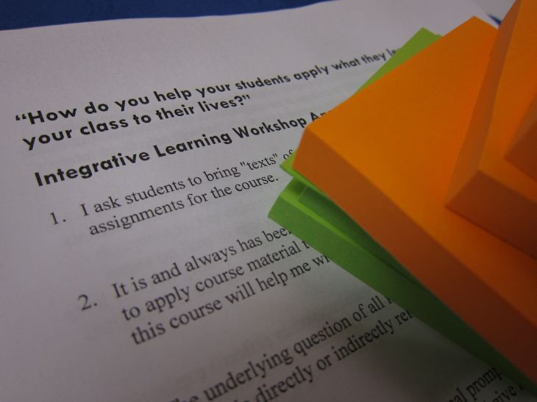
For Cultural Change to Happen What’s Needed?
Demonstrate outcomes through quantitative and qualitative information
Carving out time and opportunity for conversation. That’s where change begins and continues: faculty need to try out, reflect on and share changes big and small: successes, struggles, resistance, ideas.
Feedback loop promotes continual innovation and improvement: Keeping everyone apprised of how what they are doing in their classrooms and elsewhere is impacting student success
Sharing our work and developing expertise: Workshop artifacts and curricular infusions
Community of practice with collaborative leadership
This is ongoing work!

Slide 20
Resources and Examples of Activities
Learning Communities at Lane: A Fast Lane to Success Video
http://www.youtube.com/watch?feature=player_embedded&v=pLZWZ91343Y
Science teachers helping students to find the resources available to help them understand
http://www.youtube.com/watch?v=THyNMwaIf9c&feature=youtu.be
“Integrative Learning” as a new language: Titan Ed Talk
https://www.lanecc.edu/asa/titan-ed-talks
Cross-disciplinary talk about “a junior version of the whole game”
http://www.youtube.com/watch?v=AglJbDM2Dok&feature=youtu.be
Science and argumentative writing teachers on climate change and climate change skeptics
http://www.youtube.com/watch?v=AglJbDM2Dok&feature=youtu.be

Slide 21
Find this presentation at Lane Community College Learning Communities Faculty Resource Site:
https://www.lanecc.edu/lc/fresources/faculty-resources

