Slide 1
Lane Community College Business Department Advisory Committee
2011 - 2012

Slide 2
Overview
Business Degree Programs
Department Statistics
Department Highlights
Committee Goals
Committee Accomplishments
Cooperative Education Connections

Slide 3
Business Degree Programs
Accounting AAS
Accounting Clerk – Pathway Certificate
Bookkeeper – Pathway Certificate
Payroll Clerk – Pathway Certificate
Business Assistant – One-year Certificate
Associate of Science Oregon Transfer: Business
Administrative Office Professional AAS
Legal Office Skills – Pathway Certificate
Office Software Specialist – Pathway Certificate
Small Business Ownership – Pathway Certificate
Retail Management AAS
One-year Certificate
Career Pathway Certificate

Slide 4
Department Statistics
5 Full-time instructors 23 Part-time instructors 1 Staff for Student Resource Room and 5 Student Tutors
50 different courses, many with multiple sections
70% of courses offered both in classroom and online
Enrollment 1,800-1,900 students per term, summer about 1,000

Slide 5
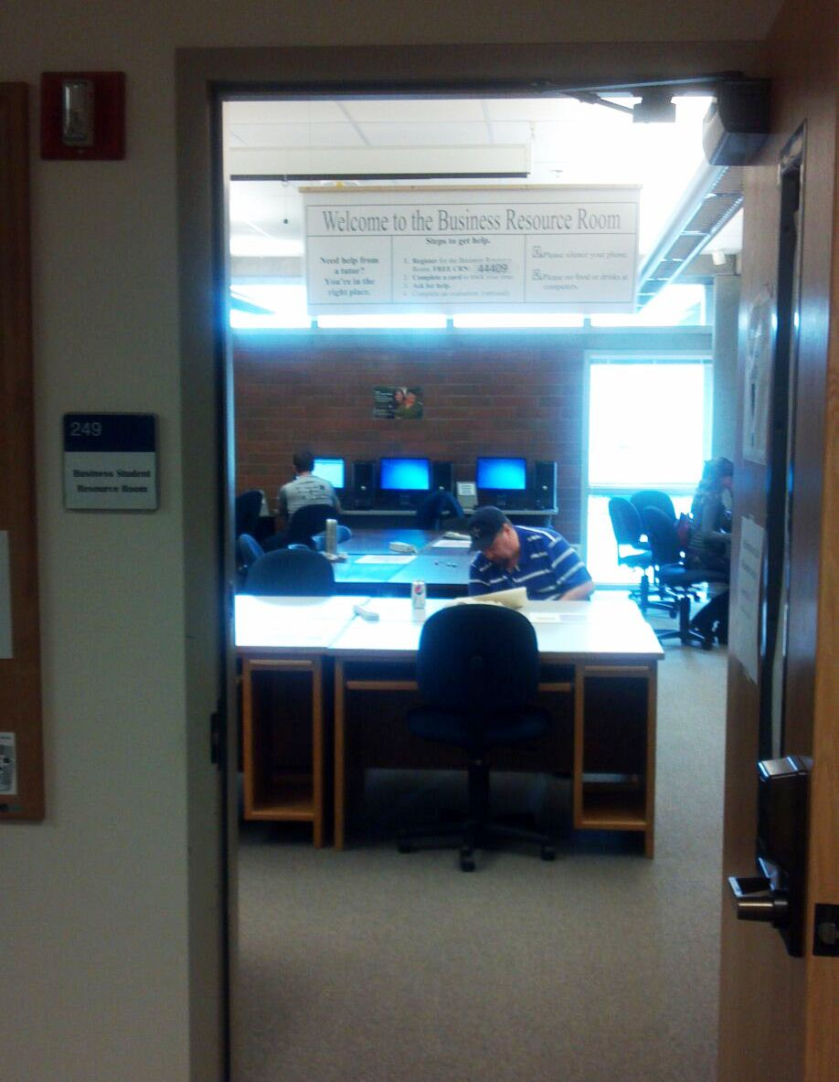
Business Student Resource Room
18 student computers
Tutors for Accounting, Excel and other software courses
Open six days a week
Student support for online classes
Proctored tests
Over 200 students served each term!
Play Video

Slide 6
Businesses Represented on Committee
GoodBooks
Notes:
Membership also includes students
Jannis Addi from Goodbooks
Nathan Bell – City of Springfield
Chip Coker – Community Mediation Services
Jeff Cook – Hershner Hunter
Russell Cox – Graduate
Tammy Den Ouden – EWEB
Trudy Hyleman- Fall Creek
LuAnne Johns – Thurston High School
Lori Kievith – City of Eugene
Ed Madrid – Robert Half Accountemps
Cari Ramirez – Hershner Hunter
Brad Wecher – Graduate

Slide 7
Working Together
Quarterly meetings
Member-hosted meetings
Sub-committees for working on goals
Social gatherings
Teamwork
Advisory Committee Wiki
Notes:
How we get it done:
Formal, agenda driven meetings
Less formal meetings at our committee member businesses
Tasks, such as goal development are done by subcommittees
We like to socialize and therefore have businesses at area businesses
We have great team work and all volunteer to get work done
To stay connected, we use the Wiki

Slide 8
Committee Goals
Diversity
Guest speakers for classes
Influence hiring decisions
Recruitment of tutors
Create an alumni network
Notes:
Diversity – evaluating ways to encourage more diversity among committee members, department faculty and business students. We’re exploring ways to fund scholarships to support diversity.
Guest Speakers – Classroom speakers available to instructors to help augment the course with real life examples.
Influencing the hiring decisions – Keep a eye on student teacher ratios. Being mindful of the administrative duties of full time instructors and express our concerns to school administration.
Tutoring – Establishing a process for volunteer tutors to assist students.
Create an alumni network – Ensuring the College stays in touch with former students to learn what worked and what instruction needs to change in order to keep up with the changing business environment.

Slide 9
Cooperative Education Community Connections
Employer Examples:
Industrial Source
All-Med
Market of Choice
Rural Development Initiative
Boone Insurance
Phil Williams, Attorney
Jones and Roth, CPA
Euphoria Chocolate Company
Local government
Bicycle shops and tattoo parlors
Everyone else
Need an intern?
Call Jamie Kelsch, Business Co-op Coordinator
Notes:
Anything and everything that people do to make money is a business and businesses need well trained and qualified staff to make them effective and efficient. The cooperative education experience truly helps to prepare a student to be well qualified to immediately contribute to a business. If your business needs an intern, contact Jamie Kelsh.

Slide 10
Business Department Advisory Committee
A Supportive and
Committed Group

