Slide 1
Parent Orientation
Welcome to the Lane Community College
Child and Family Center

Slide 2
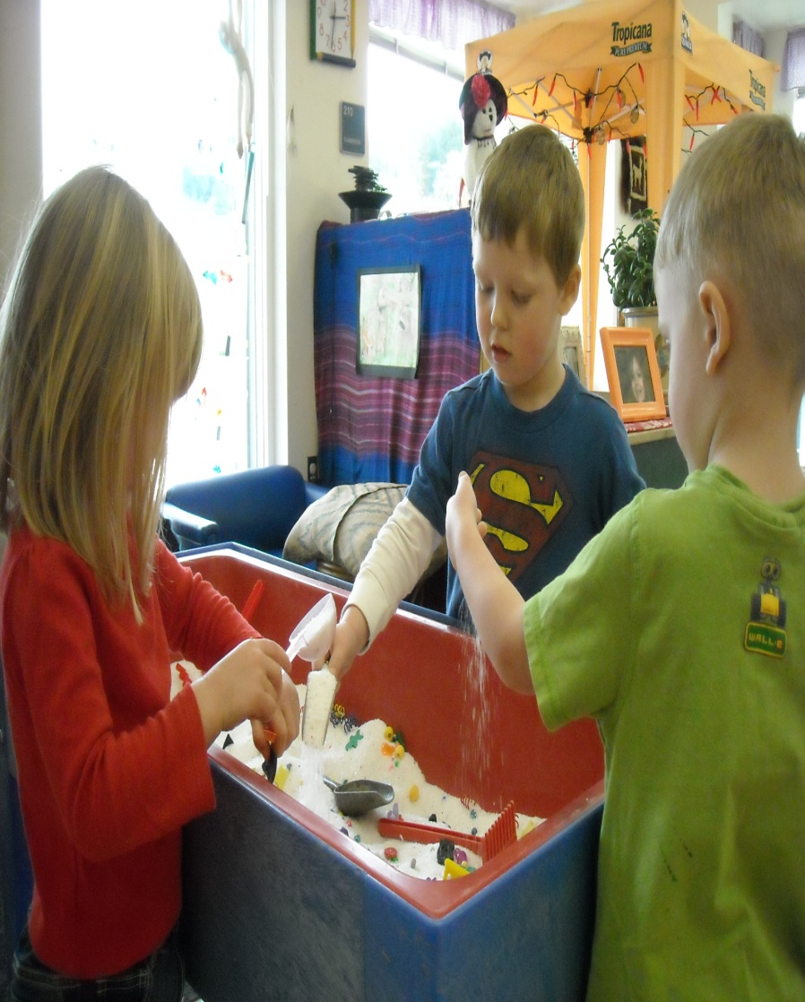
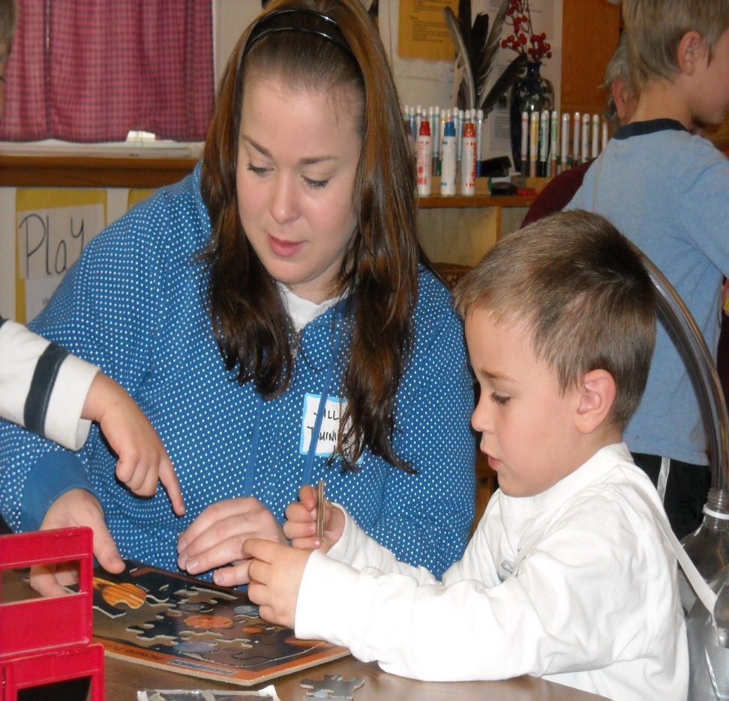
Lane Community College recognizes the vital role that quality care plays in allowing students and community members to pursue their education
and career goals.

Slide 3
Our Mission
To provide programs that support students and the community by providing quality care for children and early childhood education instruction to staff and students. We care for and nurture young children so that student and community parents are assured that their children are safe and in quality learning environments. We provide hands-on learning opportunities for early childhood education students that will assist and increase their professional development.

Slide 4
Our Program Philosophy
To encourage and support the optimal development of each child through a play-based curriculum that emphasizes exploration and discovery.
To consider, plan for, and represent all areas of children’s development (cognitive, social/emotional, physical, and language) in the classroom by observing and documenting the rich and varied interests of the children.
To promote the professional growth of our students by promoting and implementing a strong learning foundation for the children, their families and all students in the early childhood education community.

Slide 5
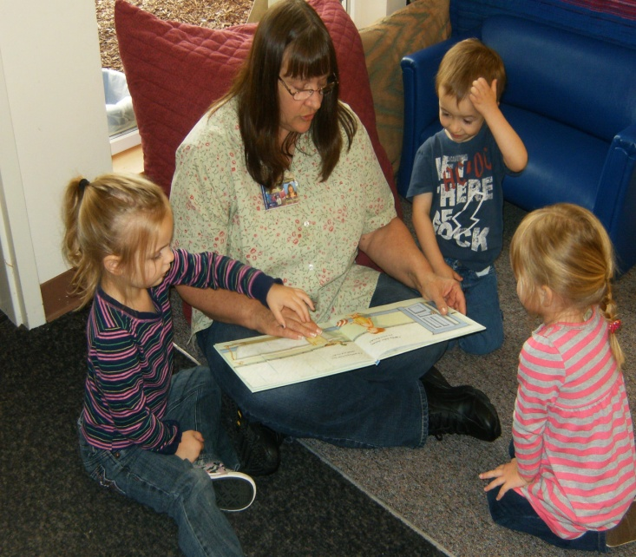
Our Center
We are open from 7 a.m. to 5:30 p.m. Monday through Friday.
We offer full day and half-day programs.
Full-day program runs from 7 a.m. to 5:30 p.m.
Morning program runs from 7 a.m. to 12 noon.
Afternoon program runs from 12 noon to 5:30 p.m.
We serve children 30 months
through 5 years old.

Slide 6
We Offer:
Large classrooms and outdoor areas to explore.
Breakfast, lunch, and afternoon snack.
Parent observation rooms to view classroom activities.
Teacher assistance from parents and Early Childhood Education students.
Individual attention for each child.
Financial assistance to help reduce the child care fees for those who are eligible.

Slide 7
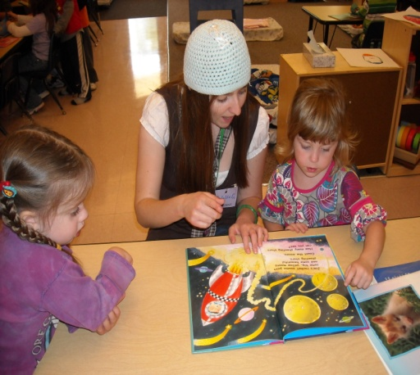
Our Classrooms
Seals Classroom
Building 25
541-463-3076
Starfish Classroom
Building 26
541-463-3188
Sea Turtles Classroom
Building 26
541-463-5524

Slide 8
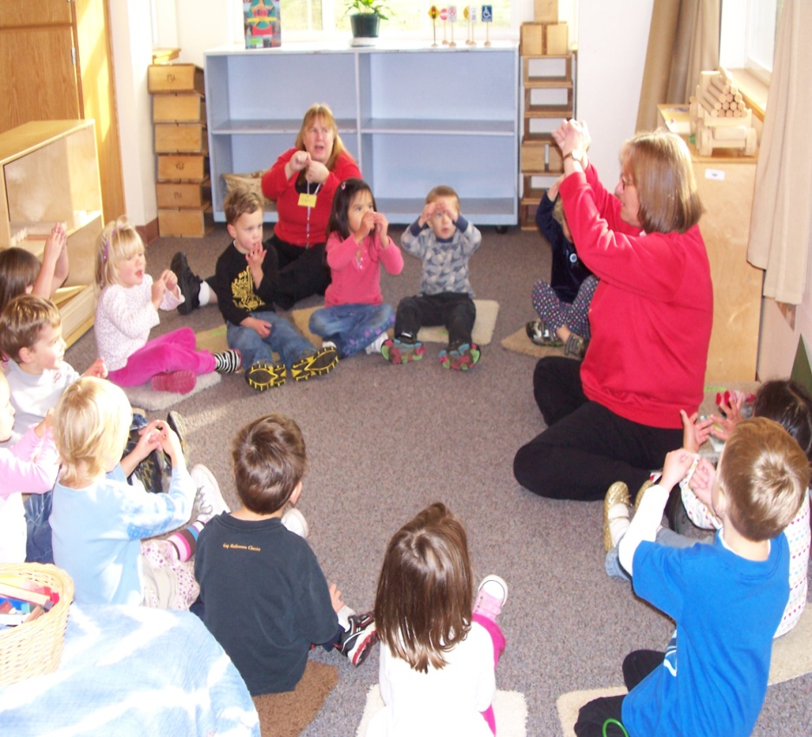
Our Teachers
Every classroom is supervised by two Lead Co-Teachers.
Teachers have extensive training in Early Childhood Education, and share a combined total of over 100 years teaching experience!
Everyone working with the children has passed the required Central Background Registry and is trained in Food Handling.
All teachers have CPR and First Aid certification.

Slide 9
Who Will Be in the Classrooms?
Head Teacher:
Please direct all classroom related questions and concerns to the head teachers.
Substitute Teachers:
Provide support when the head teachers are absent from the classroom.
Lab School Students:
ECE students work in the classroom in a learning capacity 9 hours per week.
Co-Op Parents:
Parents work in the classroom to assist the head teacher in a variety of duties.
Students and Co-Op parents are never left alone
with your child.

Slide 10
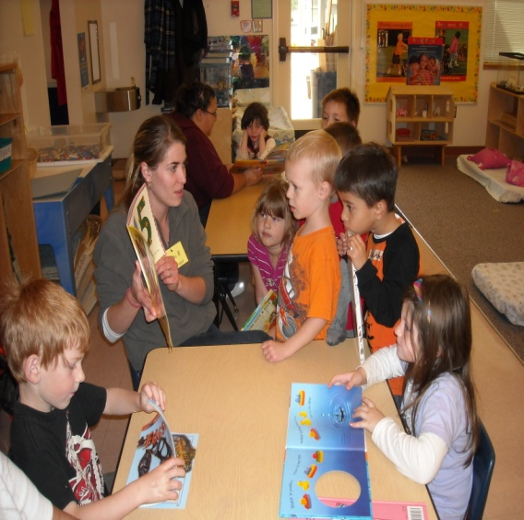
Our Curriculum
Our center follows both emergent curriculum and developmentally-appropriate practice which:
Are child-centered.
Require good observation and assessment skills.
Are part of "best practices" in early childhood education.

Slide 11
Emergent Curriculum
Developmentally Appropriate Practice
Allows learning activities to evolve from the interests of the children and parents.
Includes interests from the teachers and students working in the classroom.
Offers an engaging way for children to learn through play, doing, and self-directing.
In all aspects of program planning, the priority is for each child to develop a positive self-image.
Uses theories and methods which incorporate individual and age appropriate learning goals.
Can look very different in each classroom as the characteristics of the children, and their families, will vary.
Each teacher brings his or her unique knowledge, background and interests to the classroom which adds to the rich opportunities for learning and teaching in an appropriate environment.

Slide 12
Child Assessments
We will complete child assessments to provide information that will assist us in curriculum planning, designing goals for children, planning learning activities, and monitoring the progress of individual children.
Assessments will gather information on all areas of children’s development including cognitive skills, language, social, emotional, and physical development.
Families are encouraged to share information about their child’s interests, abilities, developmental progress or challenges at home to assist with the assessment process and planned learning activities.
Assessment results will be shared with parents during Teacher/Parent conferences held twice yearly.
When assessment results warrant further study, program staff will assist families with arranging a developmental screening and referral to Early Childhood CARES.
We ensure confidentiality of all screening and assessment results.

Slide 13
ASQ ASQ Ages & Stages Questionnaire
What is the ASQ?
The ASQ questionnaire is provided to ensure parents are informed of the development of their children is taking place within the typical developmental ranges, to screen children for any developmental delays that may qualify for specialized services, and to refer and to assist families in contacting the Early Intervention Services if there are any concerns.
The Ages and Stages Questionnaire (ASQ) is included for parents to complete as part of the childcare enrollment.
The ASQ is:
Highly recommended developmental screening tool
Uses valuable input from parents’ expert knowledge
Easy to use and save you time (take 10-15 minutes)
Reliable and accurate results
Available Online @ www.asqoregon.com
Or paper copy emailed to ECCARES @ www.eccares@uoregon.com

Slide 14
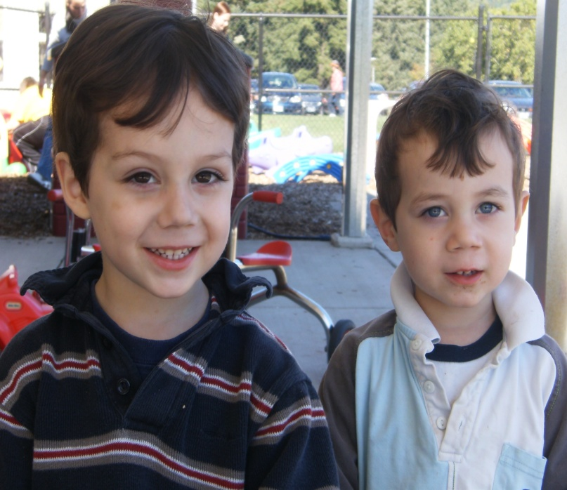
Our Guidance Procedures
We believe children progress through different stages as they grow, and we use guidance techniques suited to each particular stage.
We also believe encouragement for positive behavior is more effective than punishment for unacceptable behavior.
We make the health and safety of the children the primary concern at all times.
Above all, we offer a warm and accepting atmosphere in which the children enjoy themselves.

Slide 15
To Guide Children Positively, Our Teachers Will:
Focus on what children can do instead of on what they can’t do (avoid negative commands).
Give choices.
Encourage behavior they want continued. Positive feedback and success is the greatest motivator.
Be consistent.
Allow children time to play and make transitions to the next activity.
Change the environment to change the behavior.
Set a good example. Children model their behavior from adults.

Slide 16
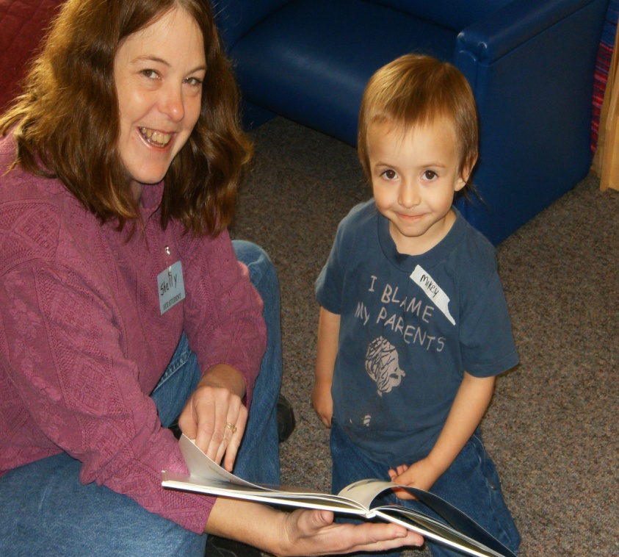
Enrollment Forms
All parents are required to complete an initial enrollment packet prior to starting the program and then paperwork updates once per year thereafter. Enrollment is for the entire year beginning in June. Parents must give two-weeks written notice to the Child Care office to withdraw from childcare to avoid additional child care charges.
Registration fees are due once per year at the time of registration.
Enrollment forms must be kept current so that we have accurate information. Therefore, we ask families to update forms once each year and as needed throughout the year.
Please inform the front office of any important family changes we should be aware of, such as:
New address, phone number or email address
Names and/or phone numbers to add to or
delete from your emergency contact list
Changes to your child’s medical history
Immunization and physical exam updates
Insurance information updates

Slide 17
Billing Procedures
The full term of child care is billed to your MyLane account.
Check your MyLane Account Summary.
All prior term charges must be paid in full to continue child care into subsequent terms.
All payments are made online or in Building #1.
Provide center information to any outside agency providing support to your child.
Two week written notice is needed to withdraw from child care to avoid additional charges.
Please stop by the office with any questions.

Slide 18
What to Expect on Your Account
Your account is billed for the full 11 weeks of the term.
Example:
Monday-Friday Full day in Preschool rate:
$194 x 11weeks = $2,134
Your first bill of the year will also reflect $55 of the $75 non-refundable registration fee. (You will have already paid $20 of the fee at time of registration.)
If you qualify for the CCAMPIS Grant, or Early Childhood Cares funding support, your Registration fee will be paid for by those funding sources.
If you qualify for the subsidy, DHS, Early Childhood Cares, NACCRRA, or any other third party payment, your account will first show the charge and then the credit.
Please talk with staff in the child care office if you have any billing questions.

Slide 19
Funding Information
Child and Family Center / Co-Op Option
All parents who pass a background check can qualify to
co-op/work up to 6 hours per week in a classroom assigned by the center director. Amount of co-op time available to you is determined by your child’s schedule.
Child and Family Child Care Subsidy
Full or part-time students of Lane taking a minimum of 6 credits, paying at least 60 % of their child care out of pocket and have their child enrolled for a minimum of 15 hours per/week may qualify to receive a child care subsidy.
CAL/CCAMPIS Grant
Qualifying students, taking a minimum of 6 credits with their child enrolled a minimum of 20 hours per/week may receive the CCAMPIS Grant. The grant covers 80% of child care expenses. Grant funding and child care space is limited and given on a first come, first serve basis. See the child care office staff for more information.
Check our website for additional funding links. www.lanecc.edu/cfe/lcfc

Slide 20
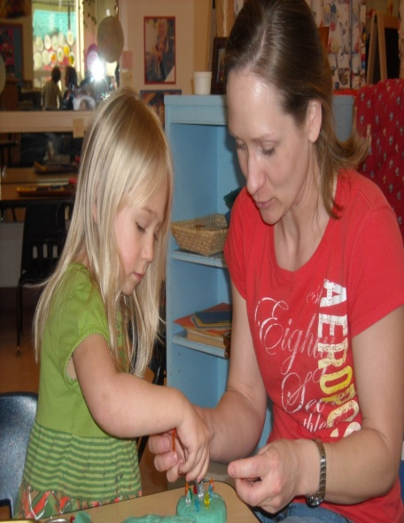
Schedules and Pick-Ups
Please make sure your child is dropped off and picked-up on time.
Each late pick-up will add an additional ½ day of child care charge (based on your current schedule)to your MyLane account.
Extended-care is included in your enrollment and is available 7:00-8:30 am and 4:00-5:30 pm and is located in either the Seals classroom for children enrolled in a classroom in bldg. 25 and the Starfish or Sea Turtles classroom for children enrolled in a classroom in bldg. 26.

Slide 21
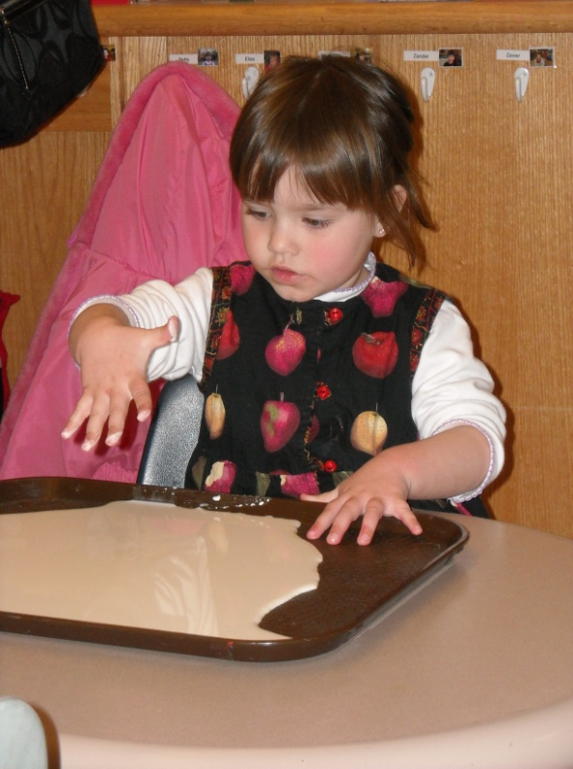
Arrival and Departure
Transition from home to school can be made easier for your child if you can establish a good-bye routine, such as:
Have a consistent arrival time.
Help your child put their coat away in their cubby.
Wash hands.
Check in with the staff.
Help your child get involved in an activity.
Remember to always say “good-bye” to your child before leaving.
Nap/Rest time is from 12:30-1 p.m. daily. We are unable to accept children for care between 12:15 and 1:30pm to ensure that rest time is not disrupted.

Slide 22
Mealtimes
Breakfast, lunch, and snack are provided and included in the tuition.
Breakfast: 8:55-9:10 a.m.
Lunch: 11:30-11:50 a.m.
Snack: 2:30-2:50 p.m.
Weekly menus are posted in each classroom.
Please notify us of any food allergies.
We are a peanut and nut free center.
USDA Nondiscrimination Statement
“In accordance with Federal law and U.S. Department of Agriculture policy, this institution is prohibited from discrimination on the basis of race, color, national origin, sex, age, or disability.”
“To file a complaint of discrimination, write USDA, Director, Office of Civil Rights, 1400 Independence Avenue, SW Washington, DC. 20250-9410 or call, toll free (866) 632-9992 (Voice). TDD users can contact USDA through local relay or the Federal relay at (800) 877-8339 (TDD) or (866) 377-8642 (relay voice users). USDA is an equal opportunity provider and employer.”

Slide 23
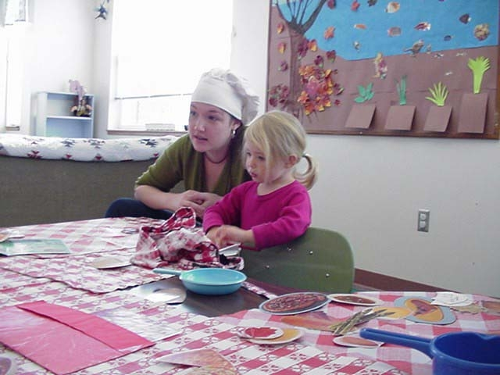
Illness Policy
Our goal is to prevent contagious conditions from entering the center. Therefore, if your child has any of the following symptoms, please keep them home for 24 hours after these symptoms are gone:
Headache and/or temperature over 100 degrees
Difficulty breathing
Rashes
Pink Eye
Vomiting
Diarrhea
Head Lice/Nits

Slide 24
Medication Procedures
All prescription medications to be administered at school must be stored in the original medication container received from the pharmacy and must state:
the prescribed medication name
child’s first and last name
date prescription was filled
dosage and administration instructions
expiration date.
A Medication Authorization Form must be completed and signed by the parent before staff can administer medications to your child.

Slide 25
Clothing and Sunscreen
To protect against cold, heat, and sun injury, please bring your child in clothing that is dry and layered.
Every child will need at least one complete change of clothing in his/her cubby.
Check your child’s cubby regularly for soiled clothing, and to replace out-grown or out-of-season clothes.
During the warmer months we will apply sunscreen to your child. Your child’s teacher will ask you to complete a Sunscreen Permission Form. You may choose to have the teachers apply sunscreen provided by the Center, or you can provide your own sunscreen.

Slide 26
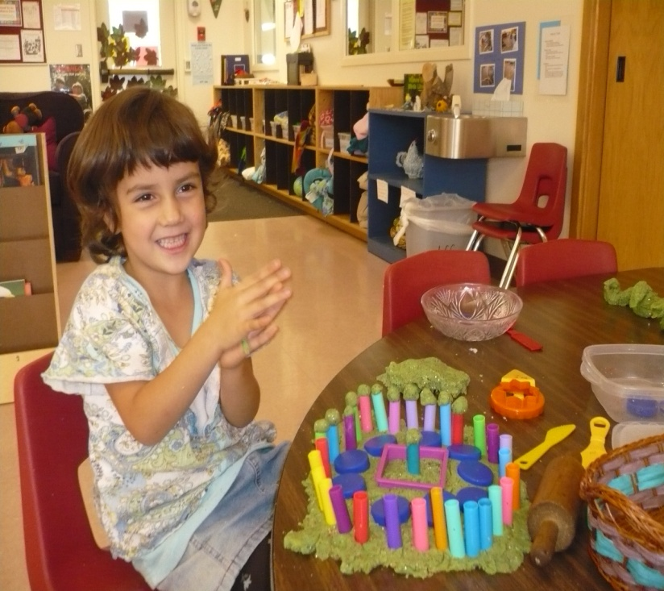
Emergency Procedures
Evacuation plans are listed in every classroom. Our center will evacuate to Building 19.
Fire and emergency drills are practiced monthly.
Additional information and procedures, including lockdowns, are located in our parent handbook.
Check KLCC 89.7 FM and other local radio stations for school closures due to weather conditions.

Slide 27
Codes
Door Codes
ProCare Computer Codes
Each family will have their own secure door code issued by the office. All of the authorized persons for each family will use the same code. If you lose or forget your code, please stop by the office.
New pick-up and drop off persons will need to stop by the office for their code.
We have a computer sign-in and sign-out system. Each person authorized by you to pick up your child will be issued a user ID and password. If you have a problem with your user ID or password come by the office for assistance. Please do not share your user ID/password with others.
New pick-up and drop off persons will need to stop by the office for their user ID and password.
Please record these numbers for reference in your cell phone.

Slide 28
Visits and Observations
Our center has an open door policy for all custodial parents/guardians.
You are welcome to visit and observe your child at any time during open hours.
If available, parents may use the observation rooms to observe their child. Observation rooms are not to be used for “homework” areas.
Parents must sign in and out at the Center office before and after observations.
All other visitors MUST be authorized, provide identification, and sign-in and sign-out at the Center office in Building 24.

Slide 29
Confidentiality
Under the Family Education Rights and Privacy Act records related to Center children and their families, and information contained in those records, are to be shared with other staff or College officials only if that person has a legitimate educational interest (i.e. on a “need to know” basis only). Requests from third parties must have parental permission. Categories of individuals that would have access to a child’s file include the following:
Child’s teacher
Parents/Legal Guardians
Director
Consultants
Administrative Staff
All children’s records are kept in a locked file cabinet. All employees are prohibited from discussing children and families with, or in the presence of, ECE students, other children and families.

Slide 30
Complaint Procedure
Lane Child and Family Center staff appreciates hearing your feedback. We aim to bring all concerns to a satisfactory conclusion for all parties involved.
Please first talk with your child’s lead co-teachers. If you wish to further discuss concerns, please feel free to schedule a conference.
If you feel your concerns are unresolved to your satisfaction at the classroom level, please contact the Child and Family Center Coordinator, Katheryn Blair at 541-463-5794.
Questions pertaining to the quality of care or specific licensing infringements may be addressed to the Lane County Child Care Division (CDC) licensing specialist at (541) 349-4132.

Slide 31
What to Expect on the First Day of School
Enter code for door and the computer, and sign-in on paper.
Help your child:
Hang up their coat.
Wash their hands.
Place all items from home in their cubby.
Talk with teacher.
Feel free to visit the observation room at any time.

