Slide 1
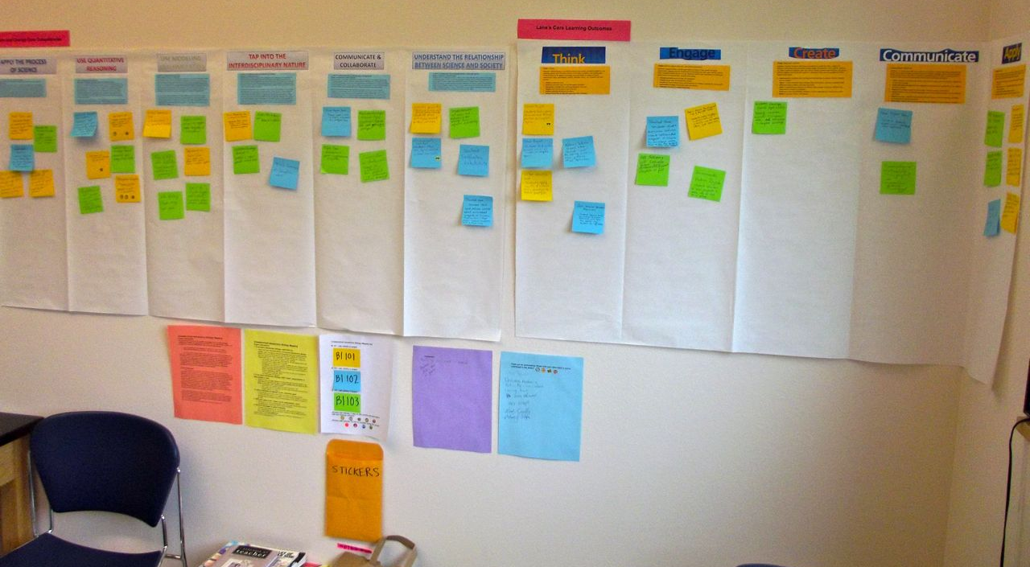
NW-PULSE @ NW BIO 2014
Crowdsource Mapping of Lane Community College’s 100 level Biology Classes to Vision and Change Core Competencies and LCC’s Core Learning Outcomes
Lane Community College
Lisa Turnbull, Stacey Kiser and Christine Andrews
VISION – Broad participation in mapping and sharing current curriculum. Identify curriculum development needs for the 100 level biology courses at LCC.
MAIN GOAL– Map Vision and Change Core Abilities to LCC’s CLOs. Provide examples of assignments that meet Vision and Change Competencies and LCC’s CLOs.
ACTIONS
ACCOUNTABILITY
RESOURCES & ALLIES
Vision and Change Core Competencies mapped to LCC’s CLOs
Crowd source project on what faculty are currently doing to meet these outcomes
Received funding from LCC’s Assessment Team to map Vision and Change Core Competencies to LCC’s CLOs
Developed new module that meets the Vision and Change Science and Society competency and LCC’s Engage Diverse Prospective CLO.
Products:
Report to the Lane Community College Assessment Team by end of May.
Pulse presentation at NWBIO May 2014
WVBEN annual report (submitted)
Assessments:
Continual conversations with faculty
Survey to faculty about future goals and how they might implement Vision and Change in their classes
Resources
LCC’s Assessment Team Funding
Lane CLOs workshop
Allies
Biology Faculty
Assessment Team members
PULSE Network
WVBEN
NABT
FUTURE GOALS
Utilize WVBEN meeting funds to bring in experts in biology education and assessment
Implement of Vision and Change and CLOs more broadly through shared curriculum
Develop assessments for Vision and Change Core Competencies and CLOs
STRENGTHS
BARRIERS & CHALLENGES
Wide participation across full time and adjunct faculty
National connections to the Vision and Change network
College connections to Assessment Team
No lead faculty for 100 level Biology classes
Time and monetary investment in curriculum development
Reduction in course offerings
General college-wide budget crisis
This work was supported in part by NSF EAGER #51588
Notes:
Photos should be at least 300dpi, but not more than 5-12 mgs each. Your poster is set to be enlarged 200% so do not change the page size to fit another poster size. Posters (3’ x 4’) will be printed at WWU or WSU using the same purchase order at the same time. Please email your poster as a PPT file to Joann Otto by April 25. Please contact Joann with questions about poster printing.
Please note that this template is provided to simplify your effort to prepare a poster for NWBio. You can change the font size, colors, column widths, add photos, institutional logos, graphics, etc. This template can also be used as a starting point and you can be as creative as you want in your poster. However, we would like to have all of the posters the same size and they will be printed at the same time, at the same print shop in order to easily pay for printing with one purchase order.

